Slide 1

校园二手交易平台
二川
报告：
贾帅威、周海月

Slide 2
目录
CONTENTS
1
设计背景
2
实现功能
3
界面设计
4
成果展示

Slide 3
1
设计背景
BACKGROUND

Slide 4
设计背景
BACKGROUND
57%
36%
川大学生人数众多，容易积攒大量闲置物品无法使用或者无需使用
大学生属于年轻群体，容易冲动消费，造成资源浪费
24%
学校没有线上平台供川大师生进行二手物品交易
对于原拥有者来说无用的物品，可能可以供他人使用
BACKGROUND
开发此APP，是为了实现川大学生之间的二手物品交易，达到资源利用最大化

Slide 5
2
预期功能
FUNCTIONS EXPETED

Slide 6

实现功能
ACHIEVEMENT
B
C
TITTLE
TITTLE
A
查看二手物品信息
发布二手物品信息
实时对话系统
检索物品信息
添加购物车功能
TITTLE

Slide 7
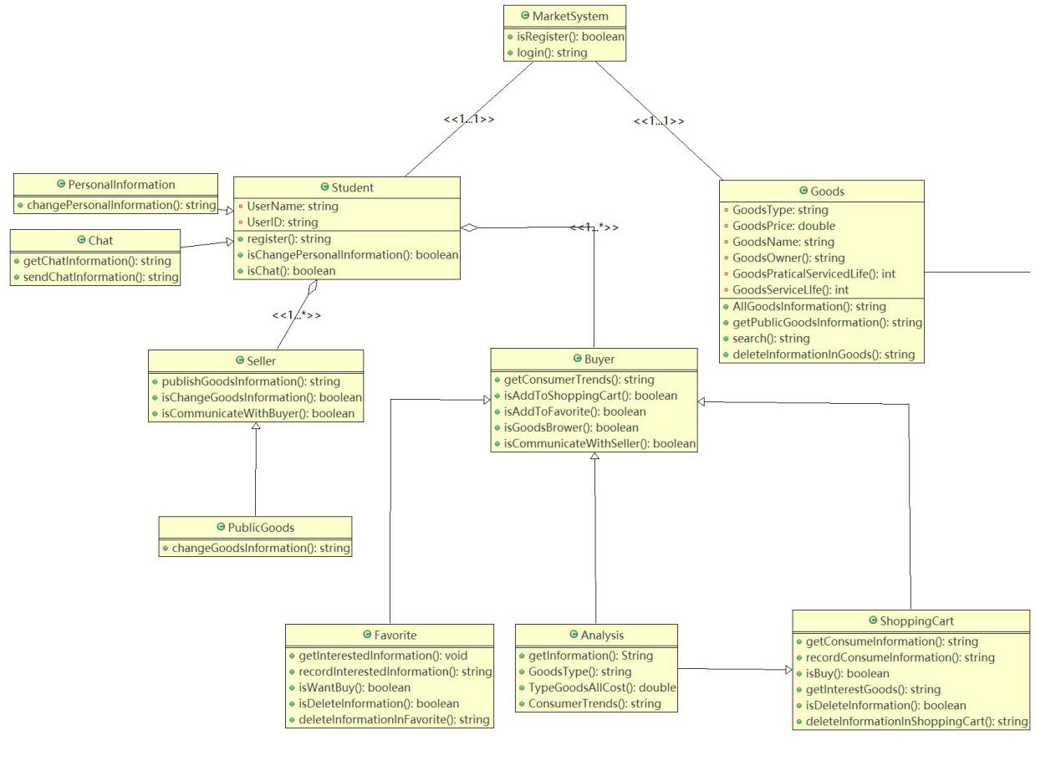

Slide 8
3
界面设计
PROTOTYPE DESIGN

Slide 9
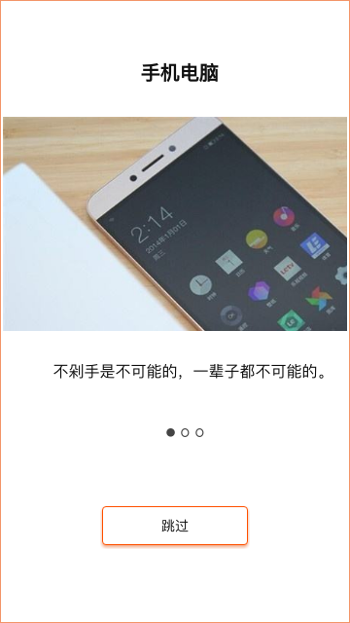
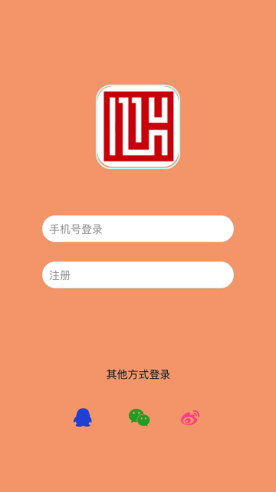

界面设计
DESIGN
此处添加标题

Slide 10
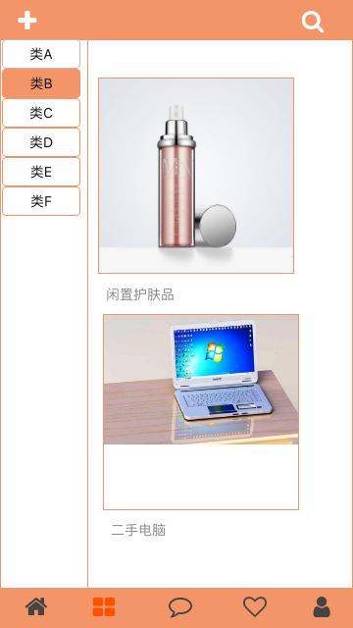
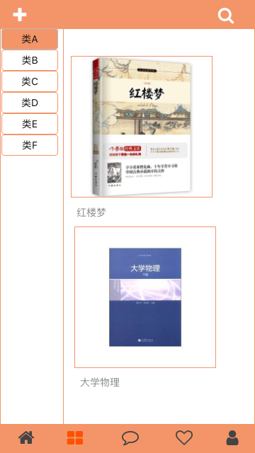
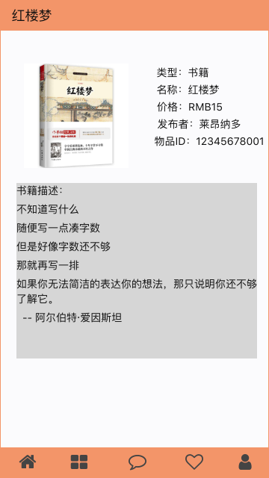
界面设计
DESIGN
此处添加标题

Slide 11
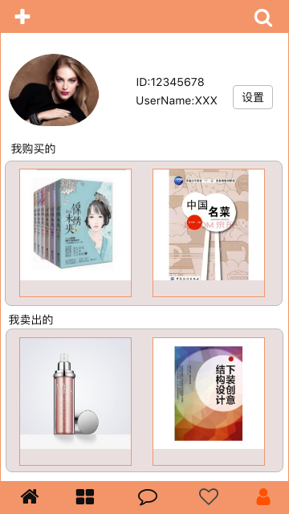

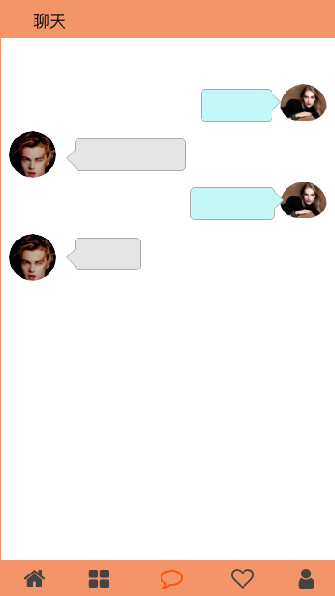
界面设计
DESIGN
此处添加标题

Slide 12

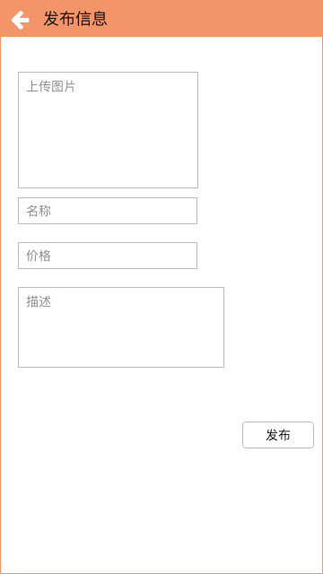

界面设计
DESIGN
此处添加标题

Slide 13
4
代码展示
ACHIEVEMENTS

Slide 14
页面布局 代码
android:layout_width="225dp"
android:layout_height="261dp"
android:layout_weight="1"
android:src="@drawable/mid_yubiao" />
<TextView
android:id="@+id/textView16"
android:layout_width="wrap_content"
android:layout_height="wrap_content"
android:layout_weight="1"
android:text=" " />
</LinearLayout>
<LinearLayout
android:layout_width="340dp"
android:layout_height="wrap_content"
android:gravity="top|left"
android:orientation="horizontal">
<TextView
android:id="@+id/textView4"
android:layout_width="5dp"
android:layout_height="wrap_content"
android:layout_weight="1"
android:text=" 账号："
android:textSize="18sp" />
<EditText
android:id="@+id/a"
android:layout_width="wrap_content"
android:layout_height="wrap_content"
android:layout_weight="1"
android:ems="10"
android:inputType="numberPassword" />
</LinearLayout>
<?xml version="1.0" encoding="utf-8"?>
<android.support.constraint.ConstraintLayout xmlns:android="http://schemas.android.com/apk/res/android"
xmlns:app="http://schemas.android.com/apk/res-auto"
xmlns:tools="http://schemas.android.com/tools"
android:layout_width="match_parent"
android:layout_height="match_parent"
tools:context=".activity_1">
<LinearLayout
android:layout_width="380dp"
android:layout_height="match_parent"
android:gravity="center"
android:orientation="vertical"
app:layout_constraintBottom_toBottomOf="parent"
app:layout_constraintEnd_toEndOf="parent">
<LinearLayout
android:layout_width="343dp"
android:layout_height="301dp"
android:orientation="horizontal">
<TextView
android:id="@+id/textView15"
android:layout_width="27dp"
android:layout_height="wrap_content"
android:layout_weight="1"
android:text=" " />
<ImageButton
android:id="@+id/imageButton1"

Slide 15
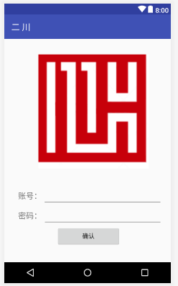
页面布局 代码
<LinearLayout
android:layout_width="340dp"
android:layout_height="wrap_content"
android:orientation="horizontal">
<TextView
android:id="@+id/textView5"
android:layout_width="6dp"
android:layout_height="30dp"
android:layout_weight="1"
android:text=" 密码："
android:textSize="18sp" />
<EditText
android:id="@+id/s"
android:layout_width="wrap_content"
android:layout_height="wrap_content"
android:layout_weight="1"
android:ems="10"
android:inputType="textPassword" />
</LinearLayout>
<Button
android:id="@+id/button1"
android:layout_width="148dp"
android:layout_height="wrap_content"
android:text="确认"
tools:layout_editor_absoluteX="100dp"
tools:layout_editor_absoluteY="126dp" />
</LinearLayout>
</android.support.constraint.ConstraintLayout>

Slide 16
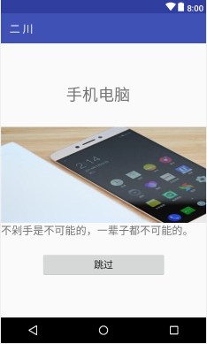
活动响应 代码_欢迎页轮播图1
package com.example.xhk170611.myapplication1;
import android.annotation.SuppressLint;
import android.app.Activity;
import android.content.Intent;
import android.os.Bundle;
import android.view.View;
import android.widget.Button;
import org.w3c.dom.Text;
import static com.example.xhk170611.myapplication1.R.id.alertTitle;
import static com.example.xhk170611.myapplication1.R.id.a;
import static com.example.xhk170611.myapplication1.R.id.s;
public class activity_1 extends Activity {
private Button b1;
private Text b2;
private Text b3;
@SuppressLint("WrongViewCast")
public void onCreate(Bundle in) {
super.onCreate(in);
setContentView(R.layout.activity_main);
b1 = (Button) findViewById(R.id.button1);
b2 = (Text) findViewById(R.id.a);
b3 = (Text) findViewById(R.id.s);
b1.setOnClickListener(new View.OnClickListener() {
@Override
public void onClick(View v) {
Intent intent = new Intent(activity_1.this, activity_05.class);
startActivity(intent);
}
});
}
}

Slide 17
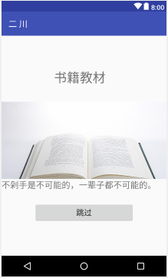
活动响应 代码_欢迎页轮播图2
package com.example.xhk170611.myapplication1;
import android.app.Activity;
import android.content.Intent;
import android.os.Bundle;
import android.view.View;
import android.widget.Button;
import android.widget.ImageButton;
public class activity_2 extends Activity {
private Button b1;
private ImageButton b2;
public void onCreate(Bundle in){
super.onCreate(in);
setContentView(R.layout.jiemian);
b1 = (Button)findViewById(R.id.c);
b1.setOnClickListener(new View.OnClickListener() {
@Override
public void onClick(View v) {
Intent intent01 = new Intent(activity_2.this,activity_1.class);
startActivity(intent01);
}
});
b2 = (ImageButton)findViewById(R.id.imageButton);
b2.setOnClickListener(new View.OnClickListener() {
@Override
public void onClick(View v) {
Intent intent02 = new Intent(activity_2.this, activity_3.class);
startActivity(intent02);
};
});
}
}

Slide 18
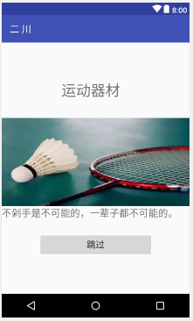
活动响应 代码_欢迎页轮播图3
package com.example.xhk170611.myapplication1;
import android.app.Activity;
import android.content.Intent;
import android.os.Bundle;
import android.view.View;
import android.widget.Button;
import android.widget.ImageButton;
public class activity_3 extends Activity {
private Button b1;
private ImageButton b3;
public void onCreate(Bundle in){
super.onCreate(in);
setContentView(R.layout.jiemian02);
b1 = (Button)findViewById(R.id.button);
b1.setOnClickListener(new View.OnClickListener() {
@Override
public void onClick(View v) {
Intent intent01 = new Intent(activity_3.this,activity_1.class);
startActivity(intent01);
}
});
b3 = (ImageButton)findViewById(R.id.imageButton);
b3.setOnClickListener(new View.OnClickListener() {
@Override
public void onClick(View v) {
Intent intent02 = new Intent(activity_3.this, activity_04.class);
startActivity(intent02);
};
});
}
}

Slide 19
代码_主页
public void onClick(View v) {
Intent intent1 = new Intent(IndexActivity.this,IndexActivity.class);
startActivity(intent1);
}
});
b2.setOnClickListener(new View.OnClickListener() {
@Override
public void onClick(View v) {
Intent intent2 = new Intent(IndexActivity.this, ListActivity.class);
startActivity(intent2);
}
});
b3.setOnClickListener(new View.OnClickListener() {
@Override
public void onClick(View v) {
Intent intent3 = new Intent(IndexActivity.this,ChatActivity.class);
startActivity(intent3);
}
});
b4.setOnClickListener(new View.OnClickListener() {
@Override
public void onClick(View v) {
Intent intent4 = new Intent(IndexActivity.this,FavoriteActivity.class);
startActivity(intent4);
}
});
b5.setOnClickListener(new View.OnClickListener() {
@Override
public void onClick(View v) {
Intent intent5 = new Intent(IndexActivity.this,UserActivity.class);
startActivity(intent5);
}
});
}
}
package cc.erchuan.com;
import android.content.Intent;
import android.support.v7.app.AppCompatActivity;
import android.os.Bundle;
import android.view.View;
import android.widget.ImageButton;
public class IndexActivity extends AppCompatActivity {
private ImageButton b1;
private ImageButton b2;
private ImageButton b3;
private ImageButton b4;
private ImageButton b5;
@Override
protected void onCreate(Bundle savedInstanceState) {
super.onCreate(savedInstanceState);
setContentView(R.layout.activity_index);
b1=(ImageButton) findViewById(R.id.imageButton7);
b2=(ImageButton)findViewById(R.id.imageButton8);
b3=(ImageButton)findViewById(R.id.imageButton9);
b4=(ImageButton)findViewById(R.id.imageButton10);
b5=(ImageButton)findViewById(R.id.imageButton11);
b1.setOnClickListener(new View.OnClickListener() {
@Override

Slide 20
代码_用户
package cc.erchuan.com;
...
protected void onCreate(Bundle savedInstanceState) {
super.onCreate(savedInstanceState);
setContentView(R.layout.activity_user);
b1=(ImageButton) findViewById(R.id.imageButton36);
b2=(ImageButton)findViewById(R.id.imageButton37);
b3=(ImageButton)findViewById(R.id.imageButton35);
b4=(ImageButton)findViewById(R.id.imageButton38);
b5=(ImageButton)findViewById(R.id.imageButton34);
s=(ImageButton)findViewById(R.id.imageButton33);
n=(ImageButton)findViewById(R.id.imageButton32);
b1.setOnClickListener(new View.OnClickListener() {
@Override
public void onClick(View v) {
Intent intent1 = new Intent(UserActivity.this,IndexActivity.class);
startActivity(intent1);
}
});
b2.setOnClickListener(new View.OnClickListener() {
@Override
public void onClick(View v) {
Intent intent2 = new Intent(UserActivity.this, ListActivity.class);
startActivity(intent2);
}
});
b3.setOnClickListener(new View.OnClickListener() {
@Override
public void onClick(View v) {
Intent intent3 = new Intent(UserActivity.this,ChatActivity.class);
startActivity(intent3);
}
});
b4.setOnClickListener(new View.OnClickListener() {
@Override
public void onClick(View v) {
Intent intent4 = new Intent(UserActivity.this,FavoriteActivity.class);
startActivity(intent4);
}
});
b5.setOnClickListener(new View.OnClickListener() {
@Override
public void onClick(View v) {
Intent intent5 = new Intent(UserActivity.this,UserActivity.class);
startActivity(intent5);
}
});
s.setOnClickListener(new View.OnClickListener() {
@Override
public void onClick(View v) {
Intent intent6 = new Intent(UserActivity.this,ResearchActivity.class);
startActivity(intent6);
}
});
n.setOnClickListener(new View.OnClickListener() {
@Override
public void onClick(View v) {
Intent intent7 = new Intent(UserActivity.this,NewthingsActivity.class);
startActivity(intent7);
}
});
}
}

Slide 21



分工
DUTY
贾帅威 ：后端
125
97
周海月 ：前端
55
38
18
王志豪 ：数据库
关键词
关键词
关键词
关键词
关键词

Slide 22
报告完毕，谢谢观看

Slide 23
此处输入章节标题
ADD YOUR TITTLE HERE
此处添加标题
此处添加详细文本描述，建议与标题相关并符合整体语言风格，语言描述尽量简洁生动
此处添加标题
此处添加详细文本描述，建议与标题相关并符合整体语言风格，语言描述尽量简洁生动
此处添加标题
此处添加详细文本描述，建议与标题相关并符合整体语言风格，语言描述尽量简洁生动
28%
35%
78%

